Slide 1

19CSE305 Machine Learning Project Presentation
A Machine Learning Approach for Predicting Disease Risk Levels from Multiple Eye Condition Indicators
Presented By
Mudumala Varnika Narayani BL.EN.U4CSE22035
Naga Ruthvika Durupudi BL.EN.U4CSE22036
Nunnaguppala Rohit BL.EN.U4CSE22040

Slide 2
Agenda
Introduction
Problem Statement
Motivation
Literature survey
Research Gap
Proposed Model/ Methodology
Results and Analysis
Conclusions and Future Scope
References
12/7/2024

Slide 3
Introduction
Objective
Evaluate ML algorithms for disease risk prediction in healthcare.
Dataset
Features: Diabetic Retinopathy, Age-Related Macular Degeneration, Diabetic Neuropathy.
Preprocessing: Data cleaning, feature engineering, scaling.
Algorithms
KNN, SVM, Decision Trees, Random Forests, Gradient Boosting.
Evaluation Metrics
Accuracy, Precision, Recall, F1-Score, ROC AUC.
Interpretability Tools
SHAP: SHapley Additive ExPlanations.
LIME: Local Interpretable Model-Agnostic Explanations.
Findings
High-performing models identified.
Most predictive features highlighted.
Impact
Supports better decision-making in healthcare.

Slide 4
Problem Statement
Importance
Accurate disease risk prediction improves patient outcomes through early intervention.
Challenges
Complex, imbalanced healthcare data with mixed features.
Traditional models struggle with reliability and interpretability.
Focus
Evaluate advanced ML models (e.g., KNN, SVM, Random Forest, Gradient Boosting).
Enhance transparency using SHAP and LIME.
Goal
Develop an accurate, interpretable model to aid healthcare decisions.

Slide 5
Motivation
Disease prediction plays a crucial role in modern healthcare, where early intervention can lead to significantly improved patient outcomes. With the rapid growth of healthcare data, including electronic health records, medical imaging, and genetic information, there is an increasing need for robust, data-driven methods that can help clinicians make informed decisions. Machine learning (ML) offers a promising solution by leveraging large datasets to predict disease risk and identify underlying patterns that might otherwise remain hidden. However, the challenges of data complexity, imbalances in the dataset, and the need for model interpretability make this task more challenging. This research aims to bridge these gaps by exploring advanced ML techniques that can provide accurate, transparent, and actionable insights for healthcare applications, particularly in predicting disease risk.

Slide 6
Literature Survey
S. No. | Paper Title (with Year) | Authors | Key Findings | Evaluation Metrics | Research Gaps
1 | Comparing different supervised machine learning algorithms for disease prediction (2019) | Uddin, Shahadat, et al. | SVM most frequently used; Random Forest shows superior accuracy; machine learning can mitigate traditional biases. | Accuracy, AUC | Limited exploration of newer ML models; Lack of cross-validation with more datasets
2 | A comprehensive study on disease risk predictions in machine learning (2020) | Saranya, G., and A. Pravin. | Highlights the use of SVM, RF, and neural networks; discusses trade-offs between specificity and sensitivity. | Accuracy, Sensitivity, Specificity | Need for improved handling of class imbalance; Limited analysis of interpretability techniques
3 | Implementation of a Heart Disease Risk Prediction Model Using Machine Learning (2022) | Karthick, K., et al. | Random Forest achieved 88.5% accuracy; chi-square feature selection used. | Accuracy, ROC curve, AUC | Feature selection techniques could be enhanced; Limited focus on real-world implementation
4 | Risk prediction model of metabolic syndrome in perimenopausal women based on machine learning (2024) | Xiaoxue, Wang, et al. | RF achieved AUC up to 0.96; SHAP values used for interpretability. | AUC, SHAP values | Lack of comparison with other ensemble techniques; Need for more diverse datasets

Slide 7
Literature Survey
S. No. | Paper Title (with Year) | Authors | Key Findings | Evaluation Metrics | Research Gaps
5 | Unsupervised machine learning for disease prediction: a comparative performance analysis using multiple datasets(2024) | Lu, Haohui, and Shahadat Uddin. | DBSCAN and Bayesian Gaussian Mixture show potential for unstructured data. | Adjusted Rand Index, Silhouette Coefficient, V-measure | Need for better handling of data quality issues; Unclear generalizability across all diseases
6 | Comparative Analysis of Machine Learning Algorithms for Liver Disease Prediction: SVM, Logistic Regression, and Decision Tree (2024) | Modhugu, Venugopal Reddy, and Sivakumar Ponnusamy. | SVM achieved 85% accuracy in liver disease prediction. | Accuracy, Precision, Recall, F1-score | Small dataset; Limited exploration of feature importance techniques
7 | Supervised machine learning models for liver disease risk prediction (2023) | Dritsas, Elias, and Maria Trigka. | SVM outperformed other models for liver disease prediction. | Accuracy, Precision, Recall, F1-score | Lack of feature selection or dimensionality reduction; Need for multi-center studies
8 | A Hybrid Approach for Heart Disease Detection using K-Means and K-NN Algorithm (2023) | Thakur, Anjali, et al. | Hybrid K-Means and K-NN improved heart disease prediction accuracy. | Accuracy, AUC | Limited focus on interpretability and transparency of models

Slide 8
Literature Survey
S. No. | Paper Title (with Year) | Authors | Key Findings | Evaluation Metrics | Research Gaps
9 | Medical big data classification using a combination of random forest classifier and k-means clustering (2018) | Manikandan, P. | Combination of RF and K-Means improved classification accuracy. | Accuracy, Precision, Recall | Lack of attention to data preprocessing and feature engineering
10 | Predicting disease risks from highly imbalanced data using random forest (2011) | Khalilia, Mohammed, Sounak Chakraborty, and Mihail Popescu. | RF achieved high AUC for imbalanced datasets. | AUC, Accuracy | Limited evaluation of model robustness to noisy data
11 | Comparing different supervised machine learning algorithms for disease prediction (2019) | Uddin, Shahadat, et al. | RF achieved the highest accuracy; SVM was most commonly used. | Accuracy, AUC | Exploration of cross-validation strategies needed for better reliability
12 | Ensemble learning for disease prediction: A review (2023) | Mahajan, Palak, et al. | Stacking achieved highest accuracy (82.6%); Bagging and Boosting used more but less accurate. | Accuracy | Further empirical validation needed on ensemble methods with diverse datasets

Slide 9
Literature Survey
S. No. | Paper Title (with Year) | Authors | Key Findings | Evaluation Metrics | Research Gaps
13 | A review of feature selection methods for machine learning-based disease risk prediction (2022) | Pudjihartono, Nicholas, et al. | Discusses feature selection for better disease prediction accuracy. | Accuracy, Feature importance | More attention on feature engineering and selection algorithms for improved prediction

Slide 10
Research Gap
Despite the promising potential of machine learning in disease prediction, several gaps remain, particularly in handling complex, imbalanced healthcare datasets. While traditional models like SVM and Random Forest have been widely used, newer ensemble methods like Stacking Classifiers have not been thoroughly explored in this context. Additionally, model interpretability remains a critical challenge, with techniques like SHAP and LIME not yet fully integrated into healthcare applications. There is also limited research on optimizing these models for real-world, resource-constrained environments, such as edge computing and IoT systems. Addressing class imbalance and improving data quality are further challenges that need attention for building reliable and generalized disease prediction models.

Slide 11
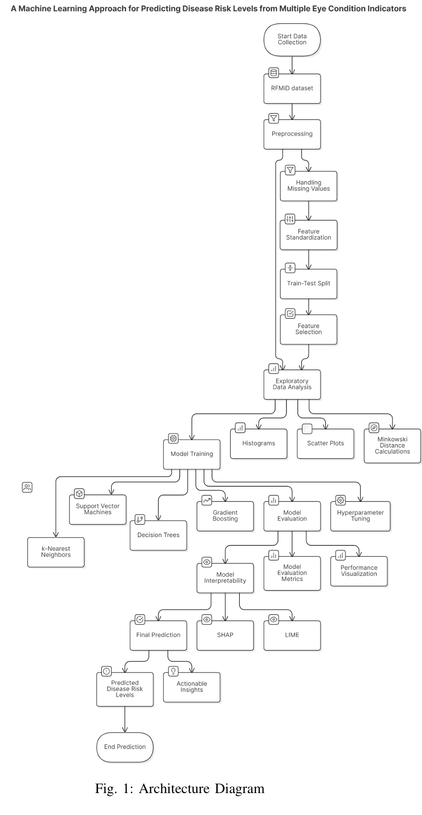
System Architecture

Slide 12
System Architecture

Slide 13
Methodology
1. Data Collection:
- Gathered structured healthcare data from RFMiD with categorical and numerical features (e.g., age, medical history, lab results).
2. Preprocessing & Feature Extraction:
- Handled missing values, normalized data using StandardScaler, and removed outliers.
- Applied PCA, Minkowski distance, and correlation analysis for feature selection.
- Visualized data with histograms and scatter plots.
3. Model Training & Evaluation:
- Split data into training (80%) and testing (20%) sets using stratified sampling.
- Trained kNN, SVM, Decision Trees, Random Forest, Gradient Boosting, and Naive Bayes.
- Optimized models with GridSearchCV and evaluated them using metrics like accuracy, F1-score, and ROC-AUC.
4. Best Model Selection:
- Identified Stacking Classifier and SVM as top performers, leveraging ensemble methods for higher accuracy and reduced false negatives.
5. Model Explainability:
- Used SHAP for global feature importance and LIME for localized instance-level insights.
- Visualized results through SHAP plots and LIME tables for transparency.

Slide 14
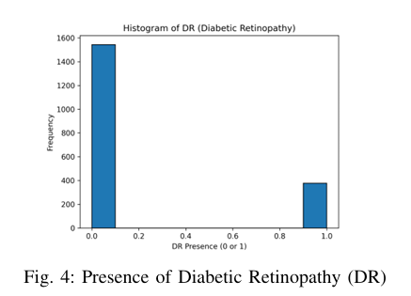
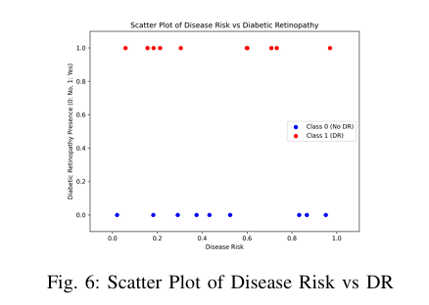
Results and Analysis
Data Preparation:
Performed exploratory data analysis (EDA), visualizing feature distributions with histograms and scatter plots (e.g., Diabetic Retinopathy, Age-Related Macular Degeneration).

Slide 15
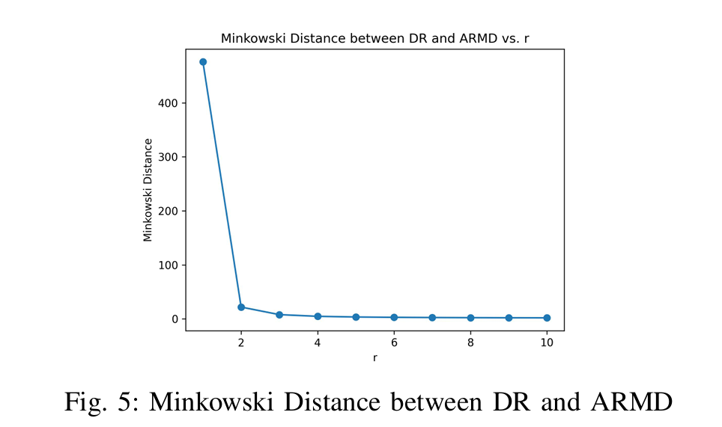
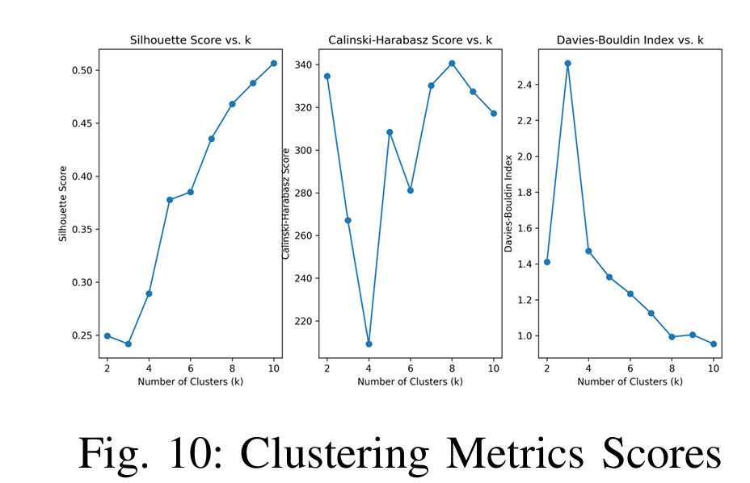
Results and Analysis
Data Preparation:
Minkowski distance analysis for feature similarity, aiding feature selection.
Clustering performance metrics, including Silhouette Score, Calinski-Harabasz Score, and Davies-Bouldin Index, evaluate cluster quality by assessing fit, separation, compactness, and inter-cluster differences.

Slide 16
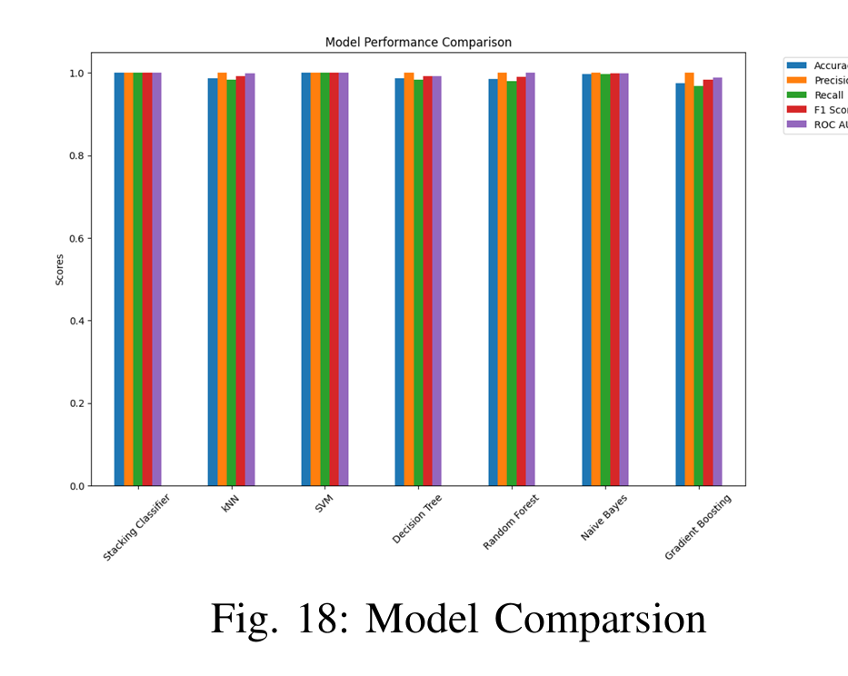
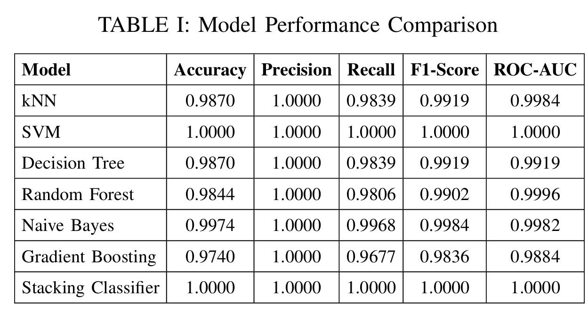
Results and Analysis
Model Performance Evaluation:
Metrics: Accuracy, Precision, Recall, F1-Score, ROC-AUC
Best Model : Stacking Classifier and SVM performs best from all the models.

Slide 17
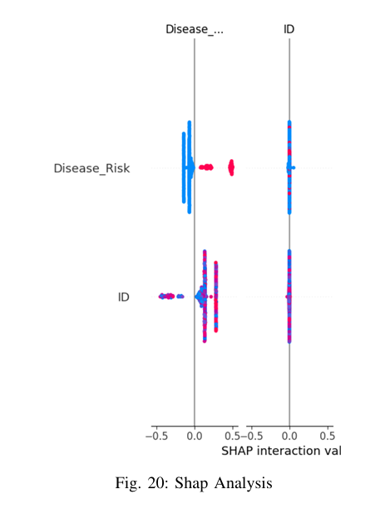
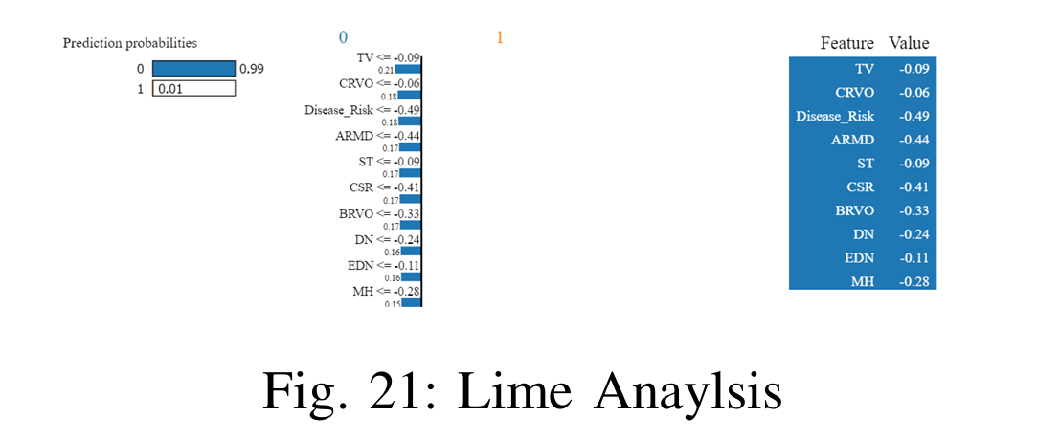
Results and Analysis
Explainable AI (XAI) :
SHAP Analysis - Reveals feature importance in Stacking Classifier predictions.
LIME Analysis - Offers localized, instance-level explanations for individual predictions.

Slide 18
Conclusion
Comprehensive evaluation of machine learning models on key metrics: Accuracy, Precision, Recall, F1 Score, and ROC AUC.
SVM and Stacking Classifier excelled with perfect scores, showcasing their robustness for disease risk prediction.
Other models (Naive Bayes, k-NN, and Random Forest) performed well under specific conditions, highlighting the need for application-specific model selection.
Emphasizes the potential of machine learning in precision-critical fields like healthcare diagnostics, advocating for Explainable AI (XAI) and adaptive systems to enhance transparency and decision-making.

Slide 19
Future Scopes
Expand applications to healthcare, fraud detection, and self-driving systems.
Enhance model precision with real-time data through adaptive learning.
Leverage ensemble techniques like SVM and Gradient Boosting for better performance.
Improve transparency in critical sectors with explainable AI (XAI).
Optimize models for edge computing and IoT to reduce computational costs.
Use transfer learning to shorten training durations by utilizing pre-trained models.
Explore quantum computing algorithms for improved performance and efficiency.
Generate synthetic data and apply resampling methods to address class imbalance and improve generalization.

Slide 20
References
[1] Uddin, Shahadat, et al. ”Comparing different supervised machine learn ing algorithms for disease prediction.” BMC medical informatics and decision making 19.1 (2019): 1-16.
[2] Saranya, G., and A. Pravin. ”A comprehensive study on disease risk predictions in machine learning.” International Journal of Electrical and Computer Engineering 10.4 (2020): 4217.
[3] Karthick, K., et al. ”[Retracted] Implementation of a Heart Disease Risk Prediction Model Using Machine Learning.” Computational and Mathematical Methods in Medicine 2022.1 (2022): 6517716.
[4] Xiaoxue, Wang, et al. ”Risk prediction model of metabolic syndrome in perimenopausal women based on machine learning.” International Journal of Medical Informatics 188 (2024): 105480.
[5] Lu, Haohui, and Shahadat Uddin. ”Unsupervised machine learning for disease prediction: a comparative performance analysis using multiple datasets.” Health and Technology 14.1 (2024): 141-154.
[6] Modhugu, Venugopal Reddy, and Sivakumar Ponnusamy. ”Comparative Analysis of Machine Learning Algorithms for Liver Disease Prediction: SVM, Logistic Regression, and Decision Tree.” Asian Journal of Re search in Computer Science 17.6 (2024): 188-201.
[7] Dritsas, Elias, and Maria Trigka. ”Supervised machine learning models for liver disease risk prediction.” Computers 12.1 (2023): 19.
[8] Thakur, Anjali, et al. ”A Hybrid Approach for Heart Disease Detection using K-Means and K-NN Algorithm.” American Journal of Electronics & Communication 4.1 (2023): 14-21.

Slide 21
References
[9] Manikandan, P. ”Medical big data classification using a combination of random forest classifier and k-means clustering.” International Journal of Intelligent Systems and Applications 10.11 (2018): 11.
[10] Khalilia, Mohammed, Sounak Chakraborty, and Mihail Popescu. ”Predicting disease risks from highly imbalanced data using random forest.” BMC medical informatics and decision making 11 (2011): 1-13.
[11] Uddin, Shahadat, et al. ”Comparing different supervised machine learning algorithms for disease prediction.” BMC medical informatics and decision making 19.1 (2019): 1-16.
[12] Mahajan, Palak, et al. ”Ensemble learning for disease prediction: A review.” Healthcare. Vol. 11. No. 12. MDPI, 2023.
[13] Pudjihartono, Nicholas, et al. ”A review of feature selection methods for machine learning-based disease risk prediction.” Frontiers in Bioinformatics 2 (2022): 927312.
[14] https://www.kaggle.com/datasets/andrewmvd/retinal-disease classification

Slide 22
References
[15] Vinayak, Vineet, Mohan Paliwal, J. Amudha, and C. Jyotsna. ”Predictionof Neuro Cognitive Disorders using Supervised Comparative MachineLearning Model & Scanpath Representations.” In 2023 IEEE 8th In-ternational Conference for Convergence in Technology (I2CT), pp. 1-5.IEEE, 2023.
[16] Nishitha, U., Revanth Kandimalla, and C. Jyotsna. ”Automobile PricePrediction using Machine Learning with Data Visualization.” In 202314th International Conference on Computing Communication and Net-working Technologies (ICCCNT), pp. 1-7. IEEE, 2023.
[17] Vinayak, Vineet, and C. Jyotsna. ”Consumer Complaints Classificationusing Deep Learning & Word Embedding Models.” In 2023 14th In-ternational Conference on Computing Communication and NetworkingTechnologies (ICCCNT), pp. 1-5. IEEE, 2023
[18] Varshith, Tummala, Thanush S. Koneri, Uppalapati Dhanush, SriramojuRahul, and C. Jyotsna. ”DeepPave: Detection of Potholes Using DeepLearning Techniques.” In 2024 2nd International Conference on In-telligent Data Communication Technologies and Internet of Things(IDCIoT), pp. 1441-1446. IEEE, 2024.
[19] Sohel, Mohammad Aman, Raghupatruni Sai Madhukar, Sai MuralidharBatchu, and C. Jyotsna. ”Unmasking Emotions: Deep Neural Networksfor Image-Based Emotion Recognition.” In 2024 2nd International Con-ference on Intelligent Data Communication Technologies and Internetof Things (IDCIoT), pp. 1045-1051. IEEE, 2024.

Slide 23

Thank you !!!!!

